Slide 1



Applying the 10 Elements for Organizational Transformation
John Butterworth
Cindy Thomas
David Hoff

Slide 2

www.ThinkWork.org

Slide 3







Notes:
JB

Slide 4


Handout Review

Slide 5

Opening Discussion
Who are you?
Why are you here?

Slide 6
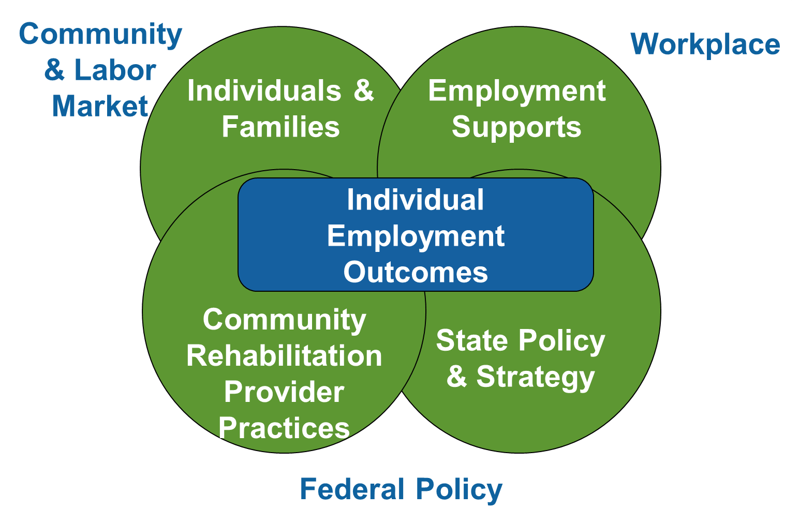
Holistic Perspective

Slide 7

Organizational Transformation Strand Overview

Slide 8

Thinking about transformation
Goal
To develop a model to support provider transformation that can be brought to scale
Delphi Panel: Framework
Case studies: How the framework looks on the ground
Intervention Study:
Organizational Transformation

Slide 9

Agency Change Toolkit
  Organizational survey
  Staff time log
  Individual outcomes log
  Site visit
Customized action planning
Monthly technical assistance
Monthly Community of Practice/webinar
Leadership summit in Washington, DC

Slide 10
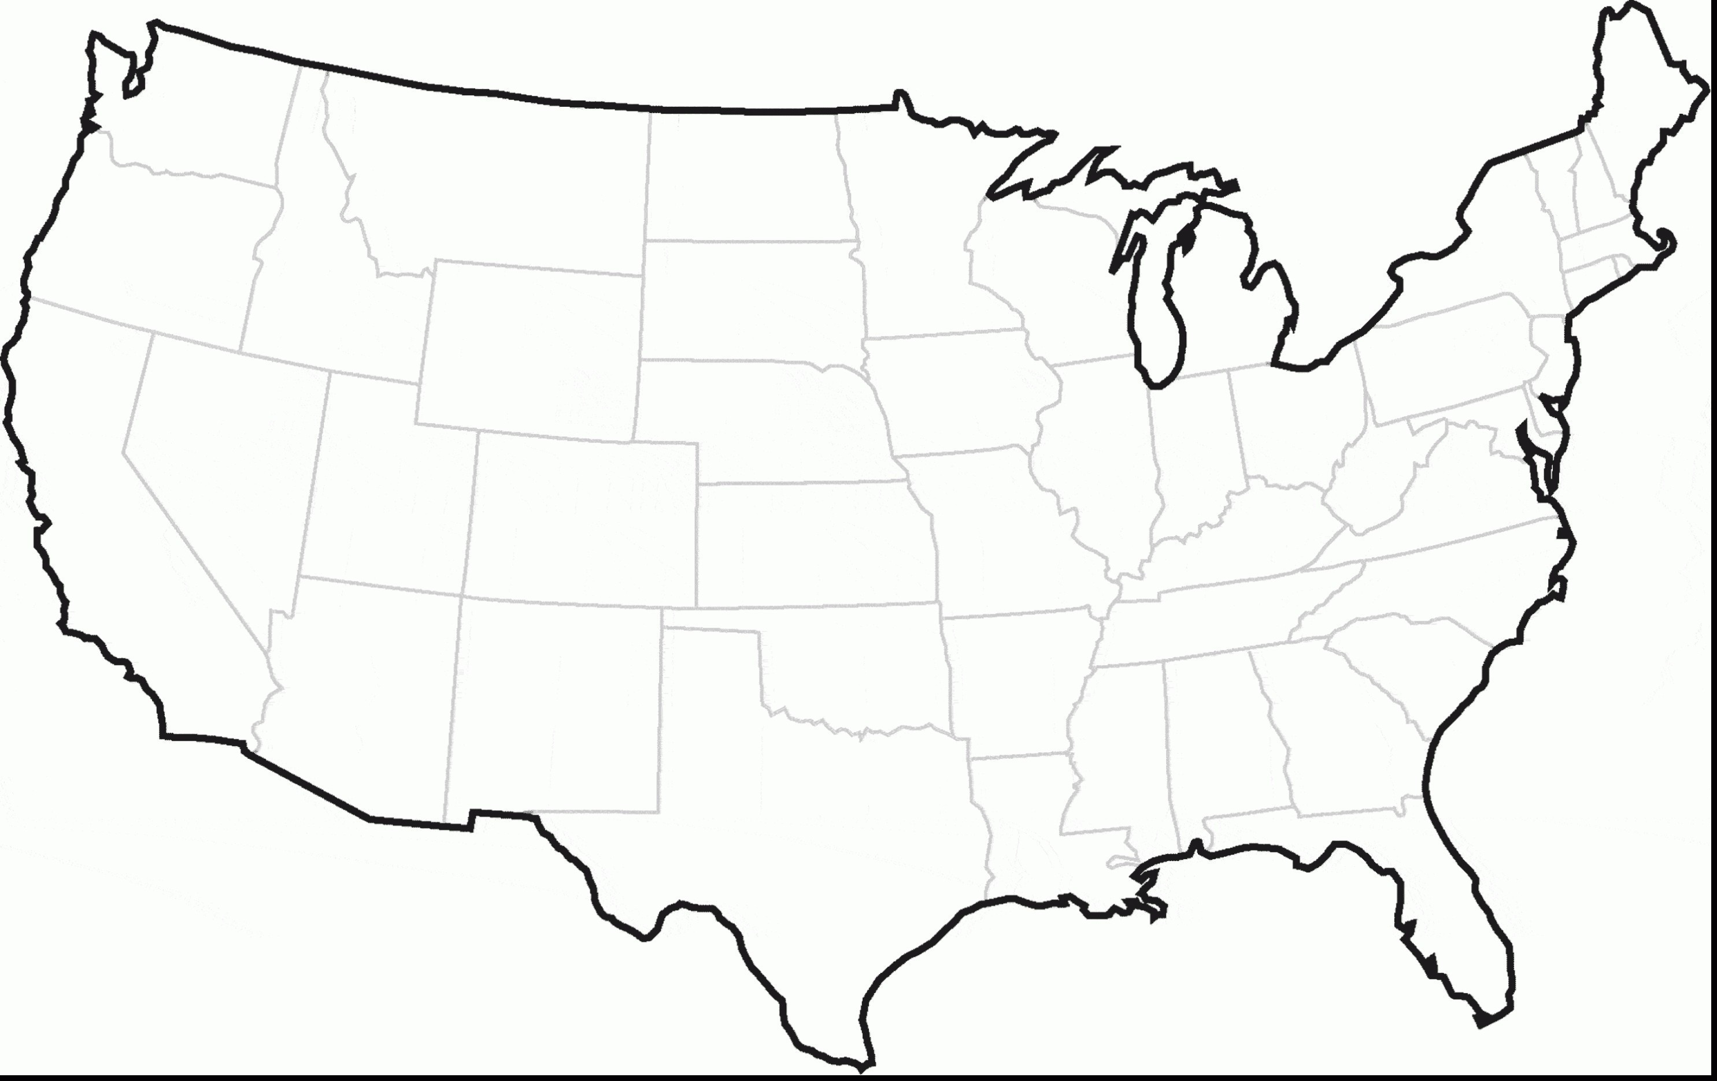











Worked with Ten Arcs across the United States on Implementation of 10 Elements
RRTC
Provider Transformation Network

Slide 11
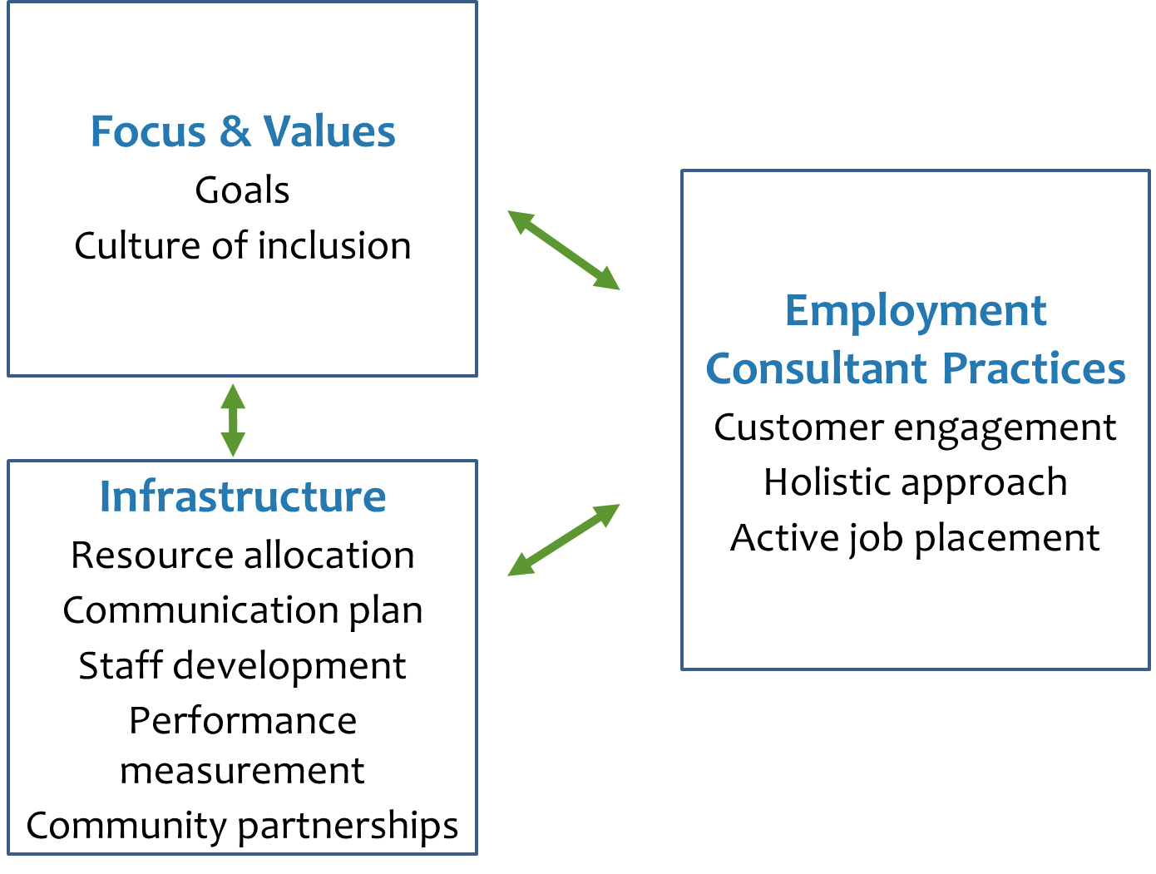
Organizational Transformation

Slide 12
Exercise –
Organizational Change: Where Does Your Organization Stand?

Slide 13

SELECT

Slide 14
Questions
What is the status of your organizational transformation efforts?
Where are you experiencing successes?
Where are you experiencing challenges?

Slide 15
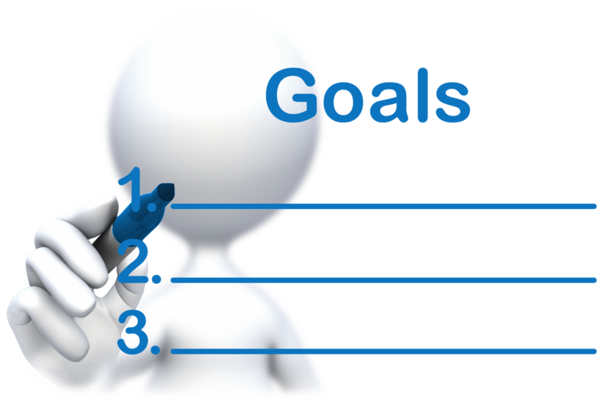
Element # 1:
Clear and Consistent

Slide 16
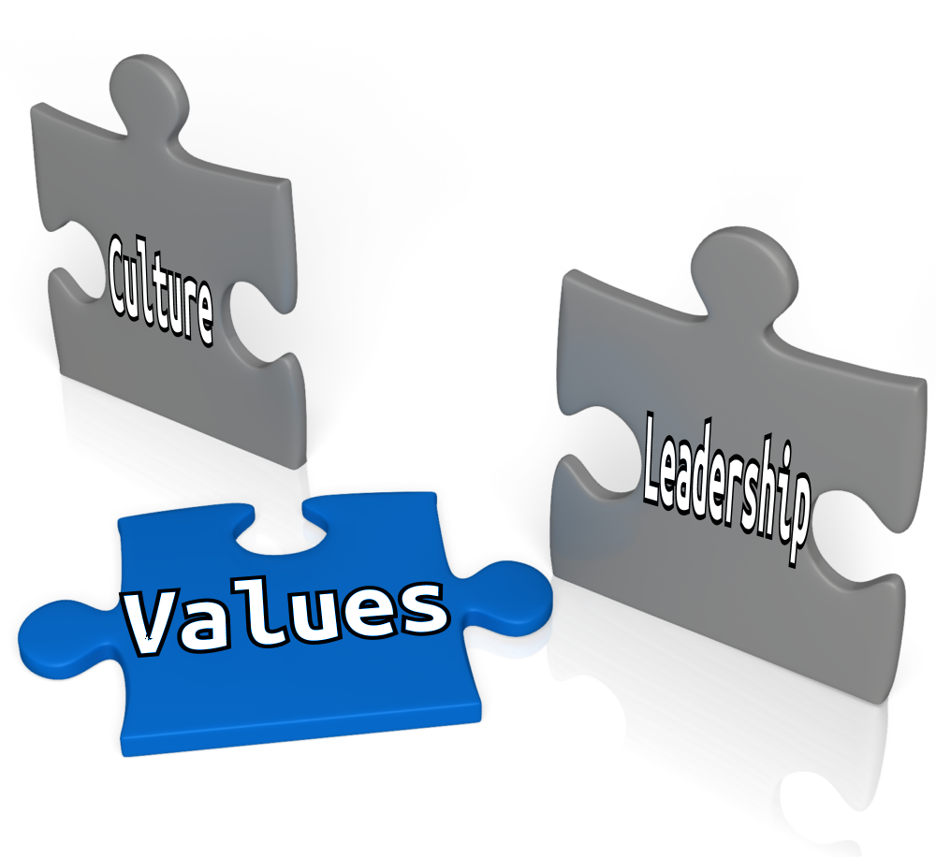
Leadership Sets the Tone
Element # 2: Agency Culture of Inclusion

Slide 17

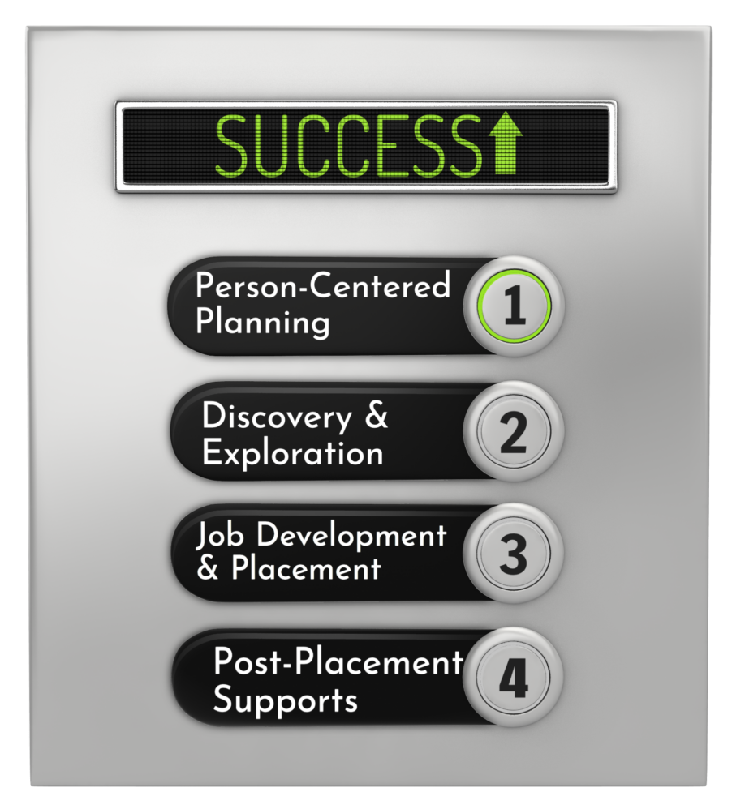

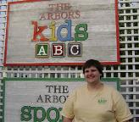
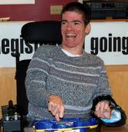
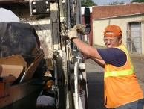

One person at a time
Element # 3:
Active Person-Centered Job Placement

Slide 18



Element # 4:
A Strong Internal & External Communication Plan
  Plans
  Needs
  Expectations
  Successes

Slide 19
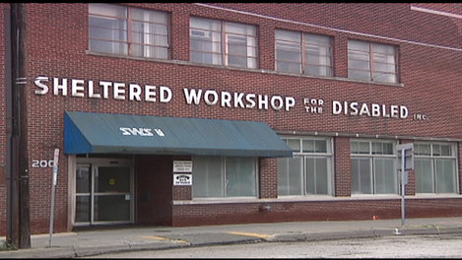
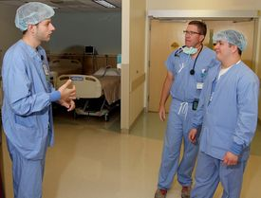

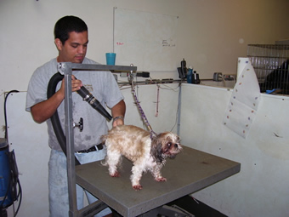
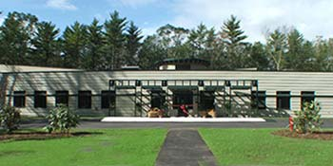
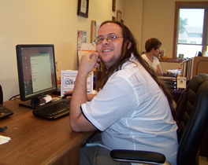
Element # 5: Reallocated and Restructured Resources

Slide 20


Element # 6:
Ongoing Professional Development of Staff

Slide 21
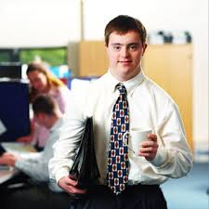

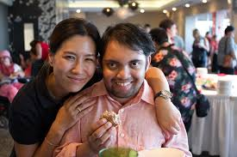
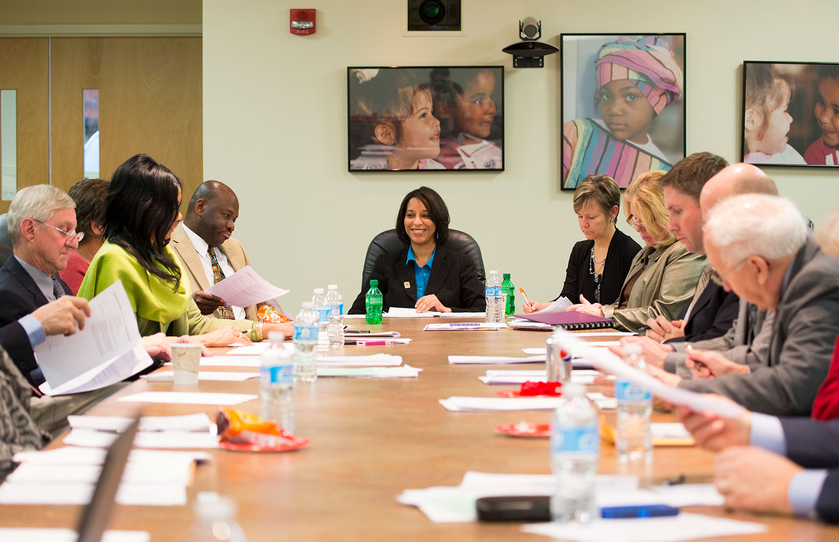
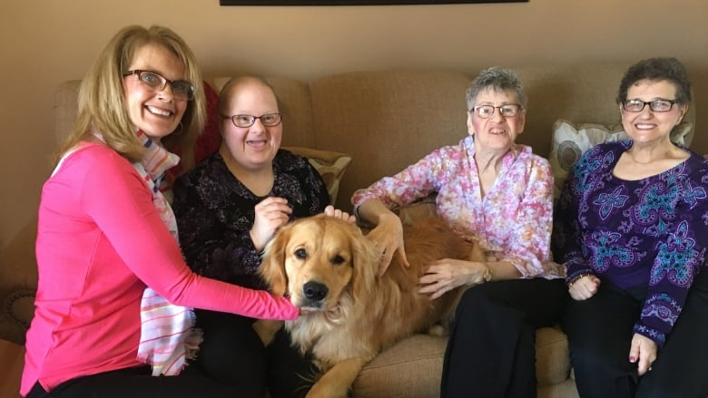
Element # 7:
Customer Focus and Engagement

Slide 22
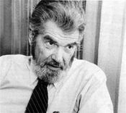
ELEMENT # 8: Performance Measurement, Quality Assurance, and Program Oversight
“If you can’t
measure it,
I’m not interested.”
- Laurence J. Peter

Slide 23
Element # 9: Holistic Approach

Slide 24


Element # 10:
Multiple & Diverse Community Partnerships

Slide 25


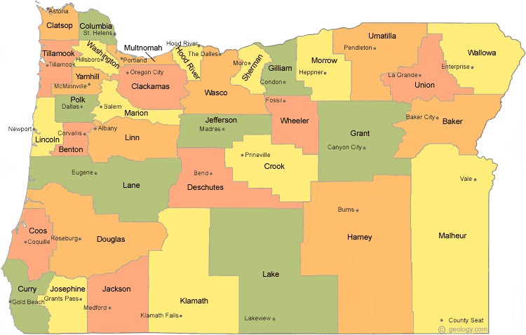
State Context
Day & Employment Service Policies
Fiscal issues
Policies
Structure (county, regional, etc.)

Slide 26
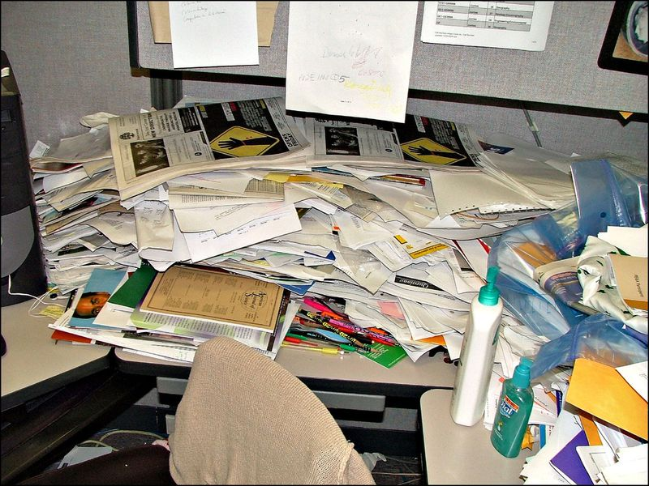

It’s Going to Be Messy and an Ongoing Process

Slide 27
Questions
What is the status of your organizational transformation efforts?
Where are you experiencing successes?
Where are you experiencing challenges?

